Slide 1
RESTFUL WEB SERVICE BASED ‘SMART PARKING SYSTEM’ USING RASPBERRY PI
By: Elvis Hlongwane
Student Number: 202007970
IPR410B – Industrial Project IV

Slide 2
Agenda
What is Home Smart Parking System(SPS)?
Problem Statement
Objectives
Specifications and limitations
Methodology
Layers
Technologies
Conclusions
Questions

Slide 3
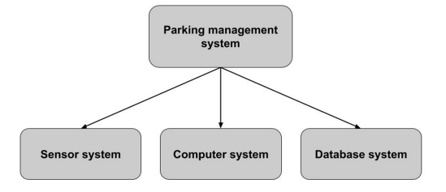
Smart Parking System(SPS)
Smart Parking System(SPS)
Collect real time data about available parking spaces of an outlet or public areas, process data, and presents data to the client(parking area user)
SPS Generic designs

Slide 4
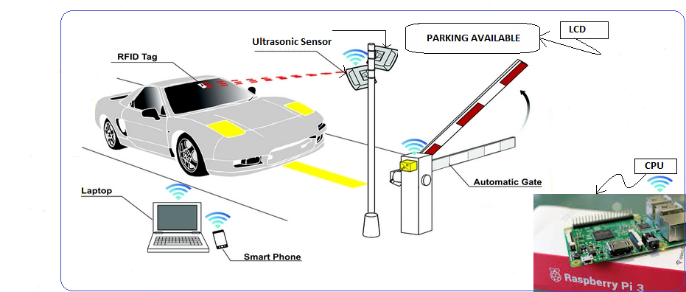
GENERAL SPS LAYOUT
General SPS Layout

Slide 5
Problem Statement
Energy-Saving
Environmental issues
Convenience, effort and time management
Monitoring and Control

Slide 6

Objectives
The purpose of this project is to
Allow car owners or customers to remotely book public parking slots in shopping complexes, or any public space,
Allow shopping complexes maintenance team to
Control parking areas
Monitor parking areas
Manage cars in car parking areas

Slide 7
SPECIFICATIONS AND LIMITATIONS
Any web browser or android application can be used to access the client application.
Central JEE container must be installed – this interfaces the client application layer and the hardware layer.
Hardware layer is made up of RBP3 Model, which is the size of the business card.
2 Ultrasonic sensor and LCD are connected to the RBP3 Model
Voltage drawn by hardware devices cannot exceed 5.1V

Slide 8
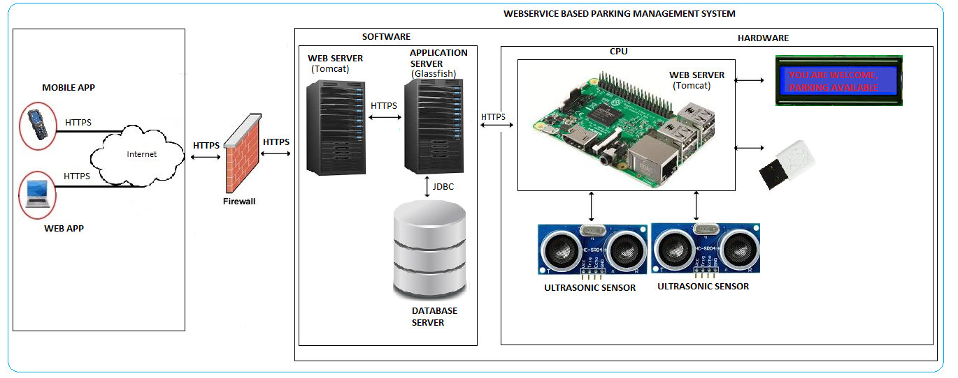
Methodology
RWSSPS is a five-layered architecture:
Client Layer
Web service layer
Application layer
EIS layer
Hardware layer

Slide 9
Layers: Client (Web/Mobile) layer
This layer represents the interface layer (browser or mobile application) that users use to perform system’s activities

Slide 10
Layers: Web service layer
The Web service layer resides in RWSSPS web server. It receives the HTTP requests from the Client layer and sends HTTP responses back in the form of JSON messages.

Slide 11
Layers: Application layer
Application layer interfaces to EIS layer through database connectivity mechanism and Hardware layer through HTTP protocol
This layer is implemented using Java and JEE technologies

Slide 12
Layers: Enterprise Information System layer
This layer makes use of SQL Database to store data.
The database is secured behind the firewall, and use the roles based mechanism to authenticate and authorize users. This layer integrates with the application layer through JDBC.

Slide 13
Layers: Hardware layer
This layer represents the hardware components of RWSSPS. Hardware layer comprises of Raspberry Pi3 microprocessor, Ultrasonic sensors, Liquid Crystal Display, and a Potentiometer.

Slide 14
Technologies
JAVA 8
Java Platform, Standard Edition (Java SE) is a computing platform for development and deployment of portable code for desktop and server environments.
JEE
Jakarta EE, is a set of specifications, extending Java SE 8
JPA
The Java Persistence API (JPA) is a Java application programming interface specification that describes the management of relational data in applications using Java Platform, Standard Edition and Java Platform, Enterprise Edition.
Spring Framework
The Spring Framework is an application framework and inversion of control container for the Java platform. The framework's core features can be used by any Java application, but there are extensions for building web applications on top of the Java EE (Enterprise Edition) platform.

Slide 15
Technologies …continued.
SPRINGBOOT
Spring Boot is a Spring framework module which provides RAD (Rapid Application Development) feature to the Spring framework. It is highly dependent on the starter templates feature which is very powerful and works flawlessly
SQL
SQL is a domain-specific language used in programming and designed for managing data held in a relational database management system (RDBMS)
DERBY DB
Apache Derby (previously distributed as IBM Cloudscape) is a relational database management system (RDBMS) developed by the Apache Software Foundation that can be embedded in Java programs and used for online transaction processing.

Slide 16
Technologies …continued.
MAVEN
Maven is a build automation tool
GLASSFISH
Glassfish is an open-source application server project started by Sun Microsystems for the Java EE platform
PYTHON
Python is an interpreted high-level programming language for general-purpose programming.
Pi4J
Pi4J Provides friendly object-oriented I/O API and implementation libraries for Java Programmers to access the full I/O capabilities of the Raspberry Pi platform
ANGULAR
Angular is a Typescript-based open-source front-end web application platform led by the Angular Team at Google and by a community of individuals and corporations.

Slide 17
Technologies …continued.
RASPBERRY PI 3B
Is Broadcom BCM2837 empowered single-board computers with 1.4GHz, 64-bit quad-core processor.
Powers up using 5V, 2,5 A
It has a built in:
CPU: 4× ARM Cortex-A53, 1.2GHz
GPU: Broadcom VideoCore IV
RAM: 1GB LPDDR2 (900 MHz)
Networking: 10/100 Ethernet, 2.4GHz 802.11n wireless
Bluetooth: Bluetooth 4.1 Classic, Bluetooth Low Energy
Storage: microSD
GPIO: 40-pin header
Ports: HDMI, 3.5mm analogue audio-video jack, 4× USB 2.0, Ethernet, Camera Serial Interface (CSI), Display Serial Interface (DSI)
PiCAM 2.1
Raspberry Pi Camera Board plugs directly into the CSI connector on the Raspberry Pi.
It's able to deliver a crystal clear 8MP resolution image, or 1080p HD video recording at 30fps

Slide 18
Technologies…continued
ULTRASON SENSORS
Ultrasonic transducers (or sensors) are a type of acoustic sensor divided into three broad categories: transmitters, receivers and transceivers
Supply voltage 5V, 15 mA, Ultrasonic frequency of 40k Hz, and a detection range of 3cm - 4m.
LIQUID CRYSTAL DISPLAY(LCD)
A liquid-crystal display is a flat-panel display or other electronically modulated optical device that uses the light-modulating properties of liquid crystals. Liquid crystals do not emit light directly, instead using a backlight or reflector to produce images in color or monochrome.
Supply voltage; 5V (4.7V – 5.3V)

Slide 19
Summary
RWSSPS is associated with high rapidly changing technology in these current times.
RWSSPS is an automated parking management system would help the car drivers to save a lot of time, help shopping complexes management teams to monitor, and effectively manage parking areas.
RWSSPS is a flexible system without boundaries; it can be operated from anywhere, at any time, and at a lower cost.
RWSSPS is not limited to shopping complexes; it can be used in firms, companies, schools, churches, or any building with public parking areas.

Slide 20


Questions?

